Slide 1
Are we at the COVID-19 peak? Epidemiologic Projections
Jinwei Hu, MD
Clinical Informatics Fellow
Department of Surgery
Department of Biomedical Informatics
University at Buffalo

Slide 2
Disclosures
None

Slide 3
Agenda
Where are we now?
What is an epidemiological model?
Are we at peak?
The Buffalo Experience
What does the future look like?

Slide 4
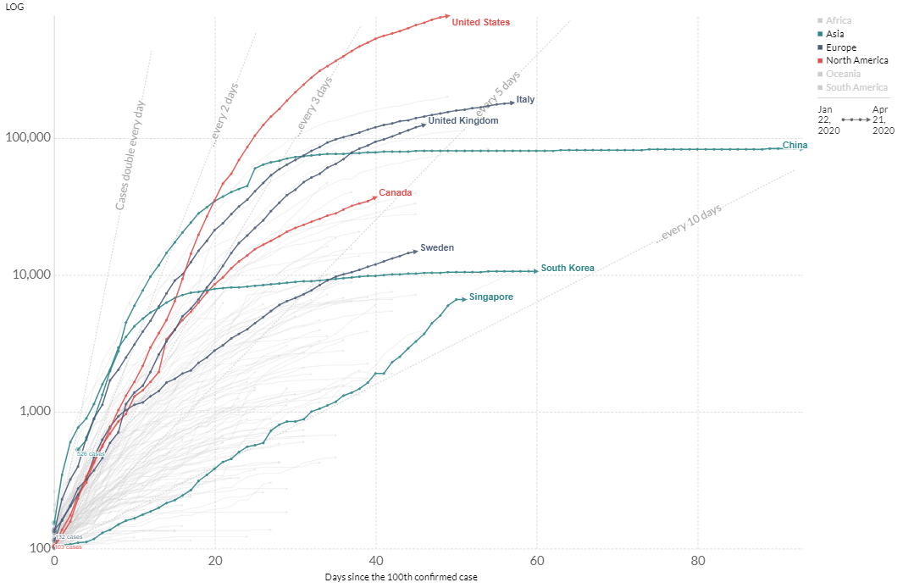
We are here.
Notes:
Following closer to Italy, will keep growing and flattening but will take time to get to the flat part similar to china/south korea
Confirmed cases, lack of testing total incidence in US? Curve would be higher with accurate testing
South korea good testing; epi was following cases in Taiwan/south korea, tracking w/ phones and cultural differences, social distancing enforced;

Slide 5
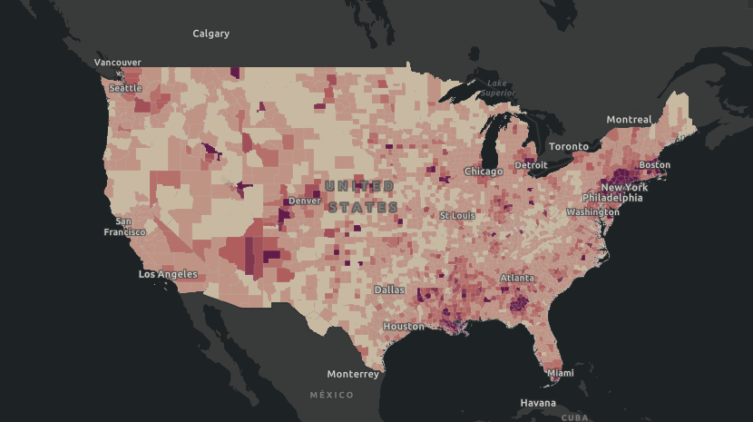
Notes:
40% in NYC
Huge difference in confirmed cases in different regions

Slide 6
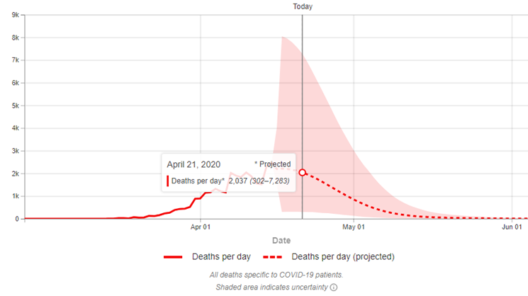
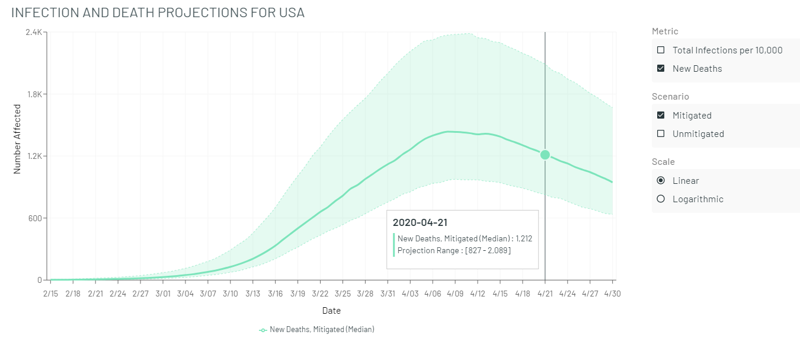
All the Pretty Models
IHME
MOBS
Notes:
IHME: https://covid19.healthdata.org/united-states-of-America
MOBS (Northeastern): https://covid19.gleamproject.org/
UT Austin TACC: https://covid-19.tacc.utexas.edu/projections/
NY graph/State Level Graphs: https://www.cdc.gov/coronavirus/2019-ncov/covid-data/pdf/2020-04-13-state-plots-no-ens.pdf

Slide 7
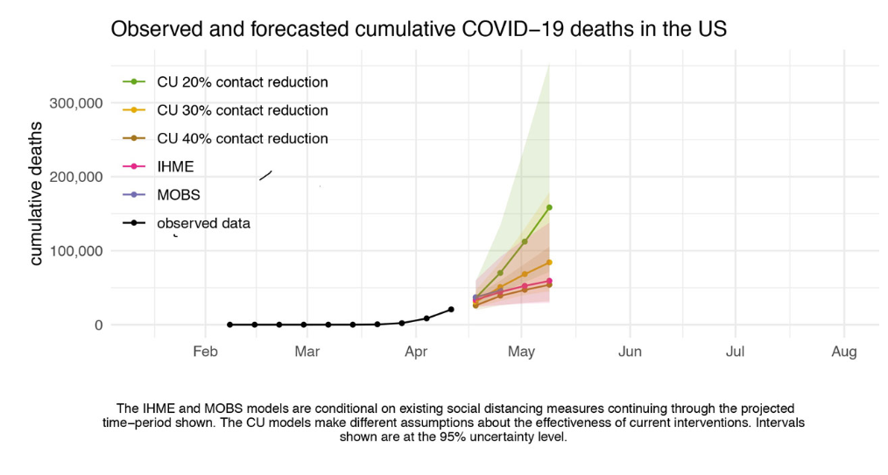
All the Pretty Models (pt 2)
CDC Aggregate
Notes:
https://www.cdc.gov/coronavirus/2019-ncov/covid-data/forecasting-us.html#cu

Slide 8
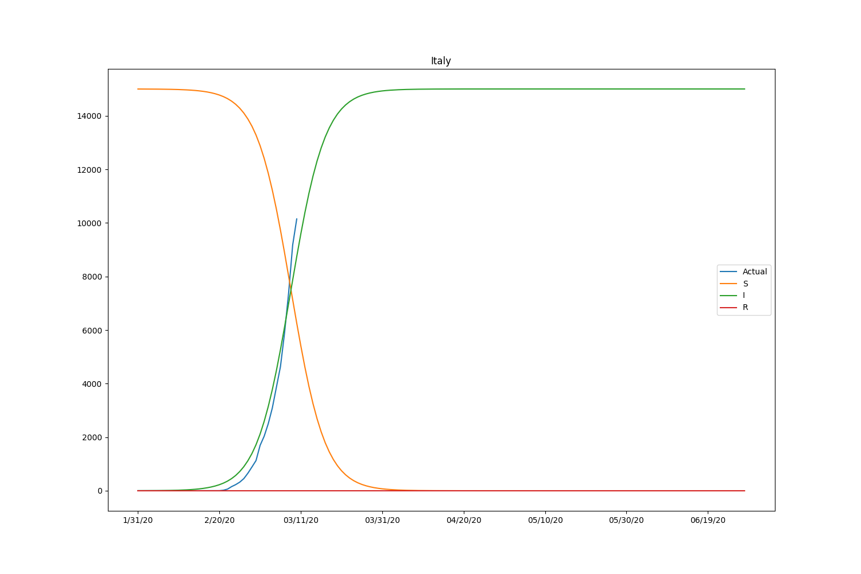
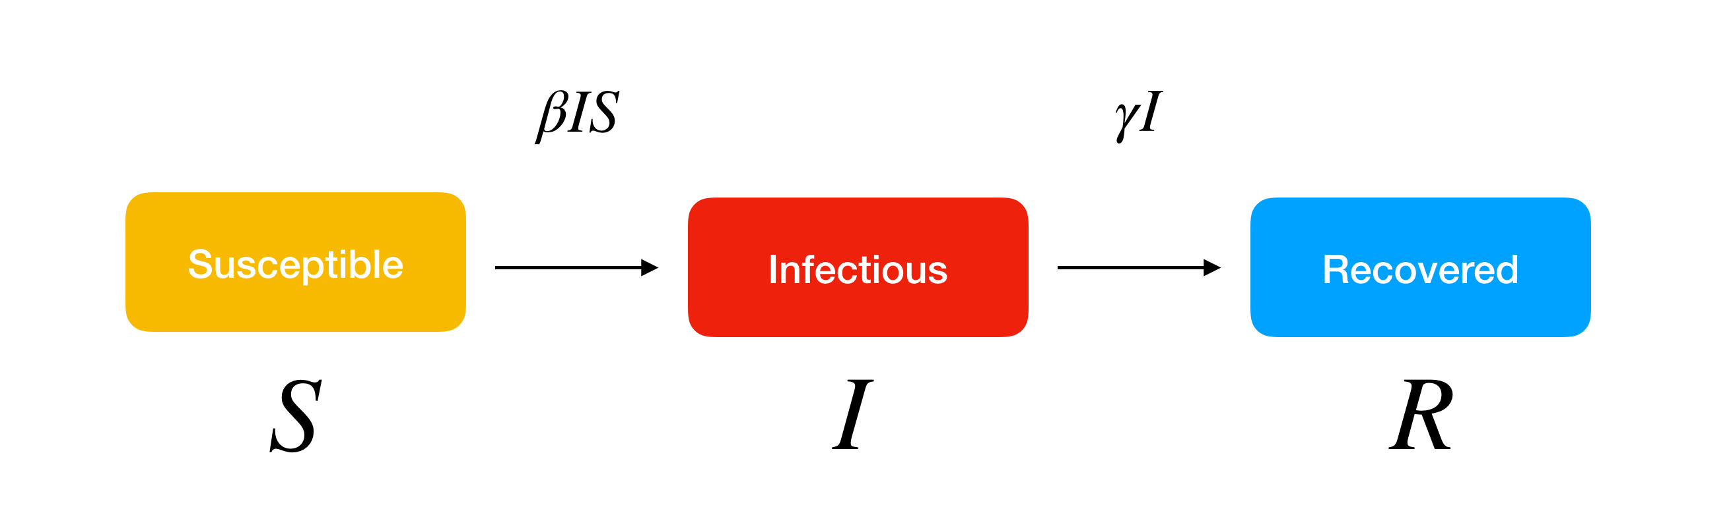
What is an epidemiological model?
Notes:
Deterministic vs stochastic
Stochastic == individual patterns
https://www.lewuathe.com/covid-19-dynamics-with-sir-model.html
R0 is is called a basic reproduction number. R0 is the average number of people infected from one other person. If it is high, the probability of pandemic is also higher. The number is also used to estimate the herd immune threshold (HIT). If the basic reproduction number multiplied by the percentage of non-immune people (susceptible) is equal to 1, it indicates the balanced state.

Slide 9
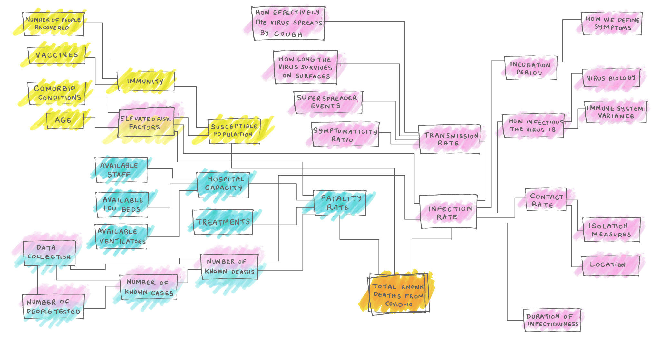
Models can get complicated…
Notes:
Virus is mutating as well
https://fivethirtyeight.com/features/why-its-so-freaking-hard-to-make-a-good-covid-19-model/

Slide 10
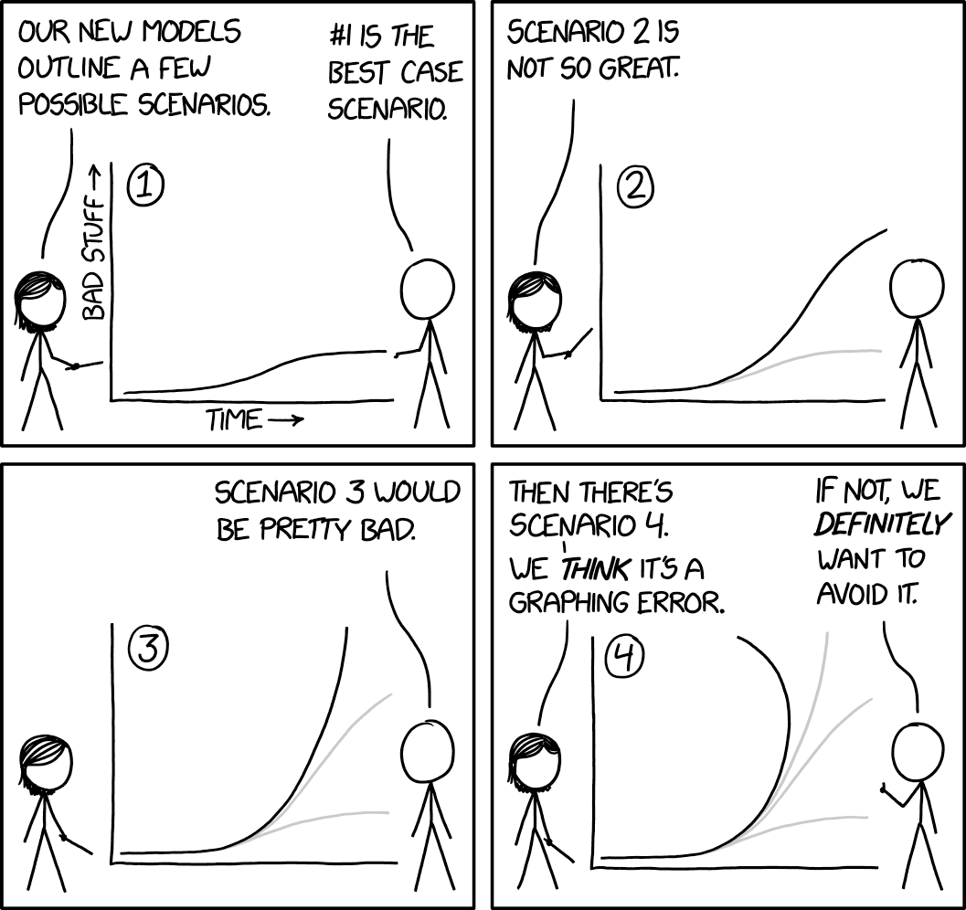

All models are bad, some are useful

Slide 11
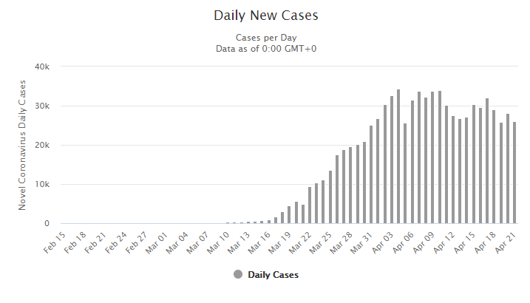
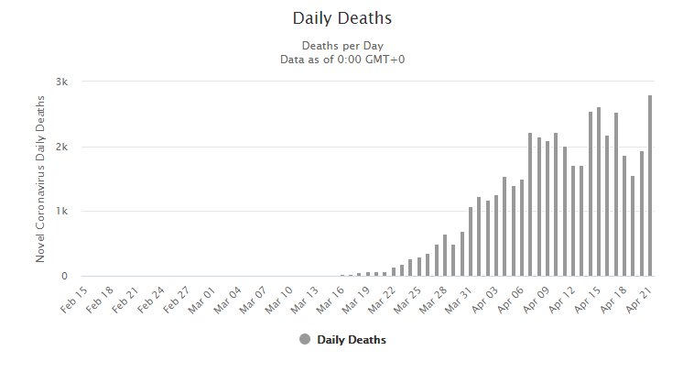
Are we at the peak?
Notes:
The first one yeah
But the peak has a downlope this is all assuming continued social distancing
So what about the future and second peaks

Slide 12
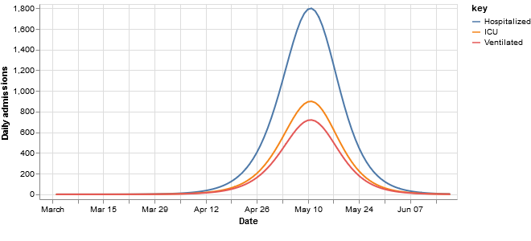
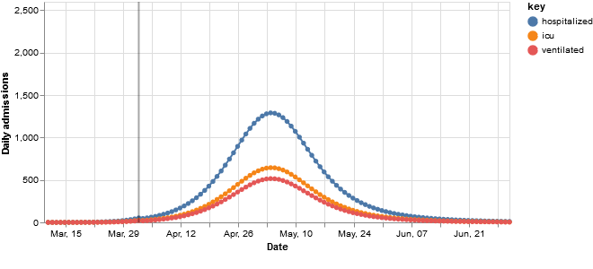
The Buffalo Experience: First steps
U Penn (CHIME) Model
Social Distancing: 0%; Peak: April 24th
Social distancing 30%; Peak May 4th
Great Lakes Healthcare – Adjusted Step Wise Model
Social distancing step-wise; Peak: May 10th

Slide 13
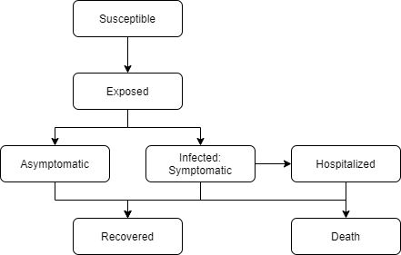
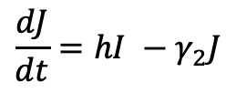
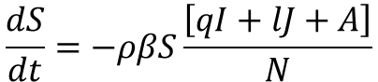
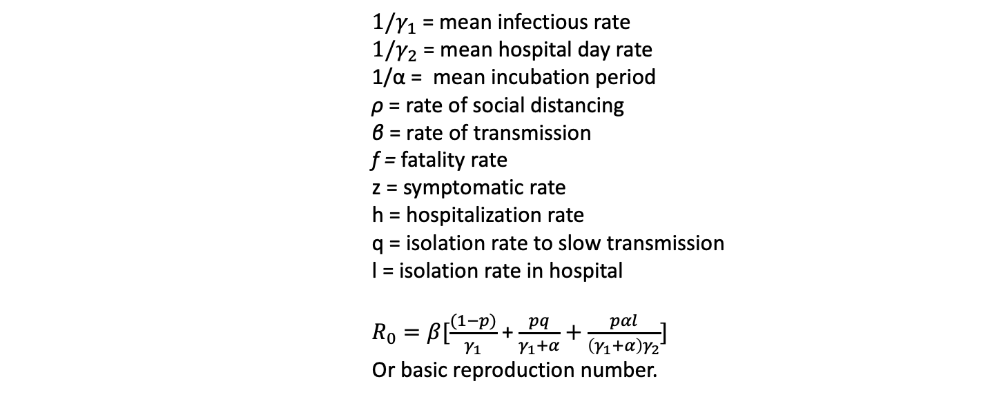
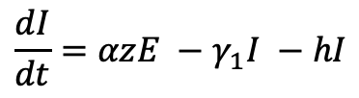
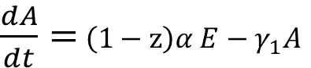
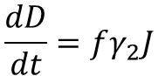
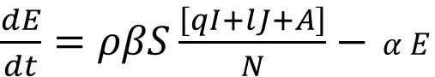
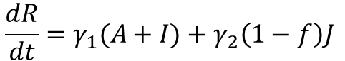
The Buffalo Experience: SEAIJRD – SEIR evolved
$$\frac{dS}{dt}=−ρβS\frac{\left[qI+lJ+A\right]}{N}$$
${1/γ}_{1}$= mean infectious rate
$1/γ_{2}$ = mean hospital day rate
1/α = mean incubation period
ρ = rate of social distancing
β = rate of transmission
f = fatality rate
z = symptomatic rate
h = hospitalization rate
q = isolation rate to slow transmission
l = isolation rate in hospital
$R_{0}=β[\frac{(1−p)}{γ_{1}}$ + $\frac{pq}{γ_{1}+α}+\frac{pαl}{\left(γ_{1}+α\right)γ_{2}}]$
Or basic reproduction number.
$\frac{dE}{dt}=ρβS\frac{\left[qI+lJ+A\right]}{N}−$ $α E$
$\frac{dA}{dt}=$ $\left(1−z\right)α E−γ_{1}A$
$$\frac{dI}{dt}=αzE −γ_{1}I −hI$$
$$\frac{dJ}{dt}=hI −γ_{2}J$$
$$\frac{dR}{dt}=γ_{1}(A+I)+γ_{2}\left(1−f\right)J$$
$$\frac{dD}{dt}=fγ_{2}J$$
Notes:
Most sensitive assumption is beta or rate of transmission since it is dependent.
We used our local data to make best guesses towards fatality rate, hospitalization rate, mean hospital day rate and social distancing (based on google trends analysis).
The rest is for the seabirds.
Again, there are many models that are out there that are more/less complicated than this.
Don’t know what beta is. We estimated this from local hospital data.
Solved for beta
r0 is an assumption based on doubling rate or real time data; early were 2.3, some are saying 1.9, ranges from 1->9, median of 5.7; really changes as time goes on. In fact in the time of measles, people estimated r0s at a difference of a factor of 1000.
r0 = rate of transmission from one person to another

Slide 14
The Buffalo Experience: Reality
0% Social Distancing
15% SD
30-40% SD
Notes:
Social distancing for the win!

Slide 15
The Buffalo Experience: Reality (pt 2)
No Intervention
School Closure
Business Closure

Slide 16
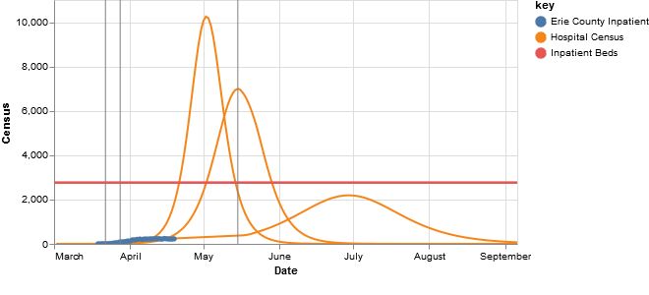
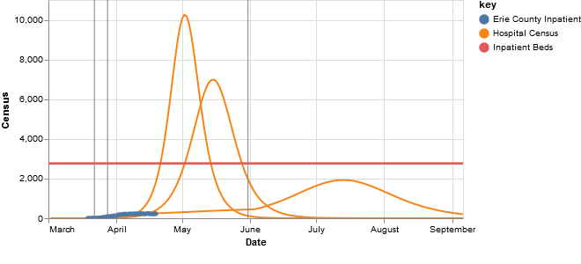
The Buffalo Experience: Adjustments
Reduction in social distancing to 75% on May 15th
Reduction in social distancing to 75% on May 31st
May 15th
May 31st
Notes:
The flatine we’re following now is assuming an 83% social distancing.
What we had before was 15-30-15% in a stepwise fashion.
The other parameters we changed included LOS (10->5) , ICU LOS (11-9). People and regions matter.
Why did this happen? Buffalo has a lower population density, public transport is not as prevalent and there are not as many public gathering places as NYC or Hunan. In NYC/Hunan people are stacked on top of each other. There are cultural differences.
Better lucky than good.
We were fortunate that we were behind NYC and knew that we had to prepare. When NYC had 100 cases, we had 3 – that’s when we started closing things. Our interventions were early and durable.
What happens in the future when social distancing ends?
The peak is earlier and slightly higher if we reduce social distancing by 75%. Really not that drastic.

Slide 17
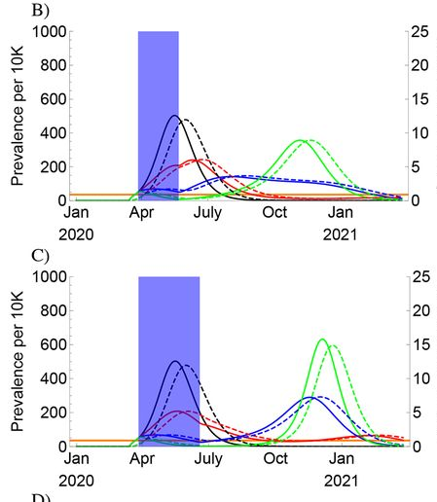
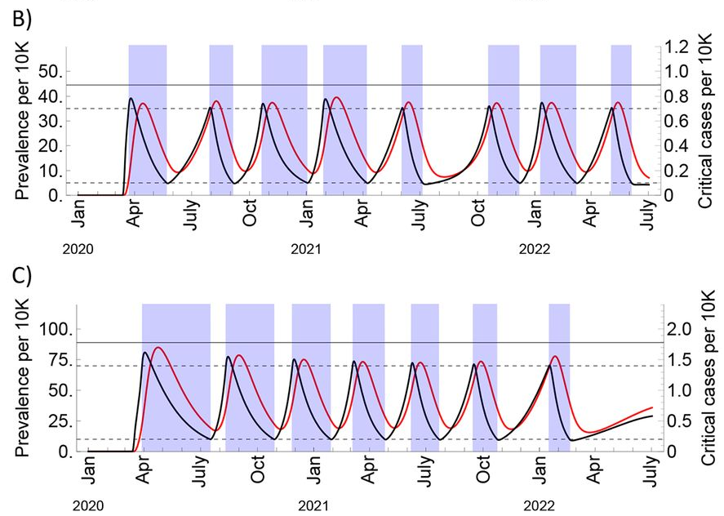
Future Waves
Notes:
https://science.sciencemag.org/content/early/2020/04/14/science.abb5793
Abstract
It is urgent to understand the future of severe acute respiratory syndrome–coronavirus 2 (SARS-CoV-2) transmission. We used estimates of seasonality, immunity, and cross-immunity for betacoronaviruses OC43 and HKU1 from time series data from the USA to inform a model of SARS-CoV-2 transmission. We projected that recurrent wintertime outbreaks of SARS-CoV-2 will probably occur after the initial, most severe pandemic wave. Absent other interventions, a key metric for the success of social distancing is whether critical care capacities are exceeded. To avoid this, prolonged or intermittent social distancing may be necessary into 2022. Additional interventions, including expanded critical care capacity and an effective therapeutic, would improve the success of intermittent distancing and hasten the acquisition of herd immunity. Longitudinal serological studies are urgently needed to determine the extent and duration of immunity to SARS-CoV-2. Even in the event of apparent elimination, SARS-CoV-2 surveillance should be maintained since a resurgence in contagion could be possible as late as 2024.
Fig. 5 One-time social distancing scenarios with seasonal transmission.(A to E) Simulated prevalence, assuming strong seasonal forcing (wintertime R₀ = 2.2, summertime R₀ = 1.3, or 40% decline), of COVID-19 infections (solid) and critical COVID-19 cases (dashed) following establishment on 11 March 2020 with a period of social distancing (shaded blue region) instated two weeks later, with the duration of social distancing lasting (A) four weeks, (B) eight weeks, (C) twelve weeks, (D) twenty weeks, and (E) indefinitely (see fig. S13 for a scenario with wintertime R₀ = 2.6). The effectiveness of social distancing varied from none to a 60% reduction in R₀. Cumulative infection sizes are depicted beside each prevalence plot (F to J) with the herd immunity threshold (horizontal black bar). Preventing widespread infection during the summer can flatten and prolong the epidemic but can also lead to a high density of susceptible individuals who could become infected in an intense autumn wave.
Fig. 6 Intermittent social distancing scenarios with current and expanded critical care capacity.SARS-Cov-2 prevalence (black curves) and critical cases (red curves) under intermittent social distancing (shaded blue regions) without seasonal forcing (A and C) and with seasonal forcing (B and D). Distancing yields a 60% reduction in R₀. Critical care capacity is depicted by the solid horizontal black bars, and the on/off thresholds for social distancing are depicted by the dashed horizontal lines. (A) and (B) are the scenarios with current US critical care capacity and (C) and (D) are the scenarios with double the current critical care capacity. The maximal wintertime R₀ is 2.2 and for the seasonal scenarios the summertime R₀ is 1.3 (40% decline). Prevalence is in black and critical care cases are in red. To the right of each main plot (E to H), the proportion immune over time is depicted in green with the herd immunity threshold (horizontal black bar).

Slide 18
Special Thanks
Department of Surgery
- Steven Schwaitzberg, MD, MS Chair
WNY Analytics Workgroup, especially :
- Peter Winkelstein, MD, MBA, CMIO of Kaleida Health
- Gabriel Anaya, MD, Clinical Informatics Fellow
- Sarah Mullin, PhD candidate
Department of Biomedical Informatics
- Peter Elkin, MD, Chair

Slide 19
Parameters as of 4/13/20
Parameter | Current Value | Prior Value | References
WNY Population | 1.5 Million
Hospitalization to Inpatient ward | 6% | 12%
Hospitalization to ICU | 1.25% (BGH Data) |  | 3% (UK) [1]
Total hospitalization rate | 2.5% [5] | 10% | 4.4% (UK); 13% (New York City) [1]
Ventilator rate | 1%
Average Inpatient LOS | 5 days (BGH Data) | 9-10 days | 8 days if not critical; 16 days if critical [1]
Average ICU LOS | 8 days (BGH+CHS Data) | 9-10 days | 10 days [1]
Average Vent LOS | 9 days (BGH+CHS Data) | 7 days
Doubling time | 3 days (Erie Data) | 2 days (Erie Data), 4, 5 days (UK, US) | [1]
Social Distancing | 0% weeks 0-2 15% week 3 [4] 30% week 3+ [3] | 0% weeks 0-2 10% week 3 30% week 3+ | [2] 30% (UPenn) [3] Google Mobility [4]
Notes:
References:
https://medium.com/@tomaspueyo/coronavirus-the-hammer-and-the-dance-be9337092b56
https://medium.com/@tomaspueyo/coronavirus-act-today-or-people-will-die-f4d3d9cd99ca
https://www.worldometers.info/coronavirus/
https://www.worldometers.info/coronavirus/country/us/
[1] https://www.imperial.ac.uk/media/imperial-college/medicine/sph/ide/gida-fellowships/Imperial-College-COVID19-NPI-modelling-16-03-2020.pdf
[2] http://predictivehealthcare.pennmedicine.org/2020/03/18/compare-chime.html
Average interactions per day are 12. Adults have family (40%), non-essential (70%. Kids have school (70%), non-essential(12%), essential (12%)
[3] https://www.gstatic.com/covid19/mobility/2020-03-29_US_New_York_Mobility_Report_en.pdf
[4] Impact of school closures for COVID-19 on the US health-care workforce and net mortality: a modelling study; https://www.thelancet.com/pdfs/journals/lanpub/PIIS2468-2667(20)30082-7.pdf
[5] Estimates of the severity of COVID-19disease; https://www.medrxiv.org/content/10.1101/2020.03.09.20033357v1.full.pdf

Slide 20
Parameters cont.
Parameter | Value | New Data | References
Community Attack Rate | 40%
Fatality Rate | Overall: 0.5% Hospital: 4% |  | [1] Age group specific
R0 | Estimated from doubling time
Infectious period | 2.9 days
Incubation period | 5.8 days | 5.2 days
Recovery time (mild) | 11 days
Days from infection to death | 21.3 days
Days from infection to admit/intubation | 5 days
Infectious period | 6 days
Days in critical care or dies | 4 days

Slide 21
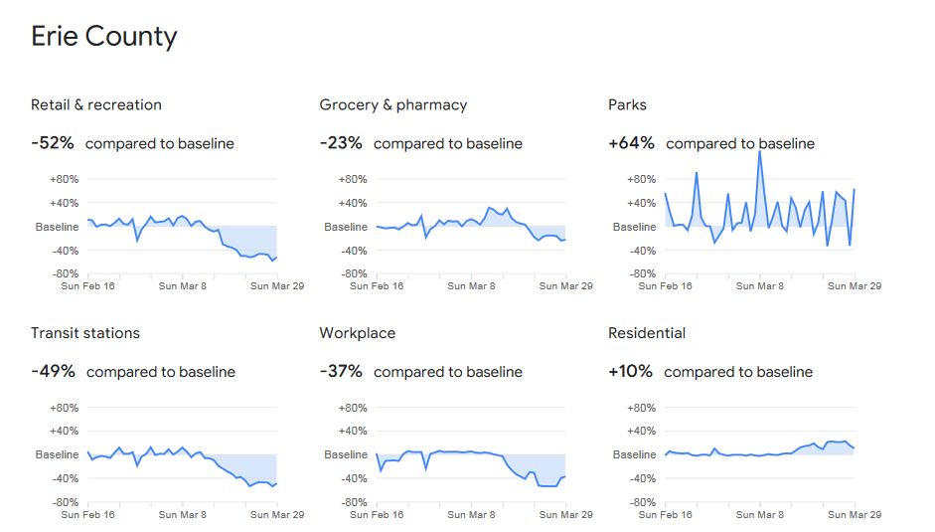
Google Mobility Changes
Baseline: median value Jan3-Feb6
Estimated 30-40% Social Distancing
Retail and Recreation: -52%
Grocery & Pharmacy: -23%
Parks: +64%
Transit Stations: -49%
Workplace: -37%
Residential: +10%

Slide 22
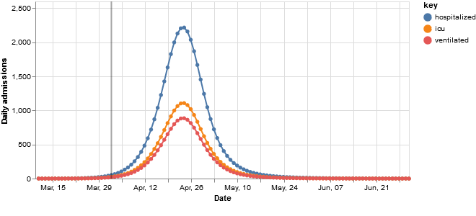
(Old Version) Model Comparison with UPenn
Great Lakes Healthcare – Adjusted Step Wise Model
Social distancing step-wise; Peak: May 10th
U Penn
Social Distancing: 0%; Peak: April 24th
Social distancing 30%; Peak May 4th
Notes:
We would be in between the two peaks of Upenn due to our slower transition to social distancing compared to starting at 0 or 30% for the whole model.

Slide 23
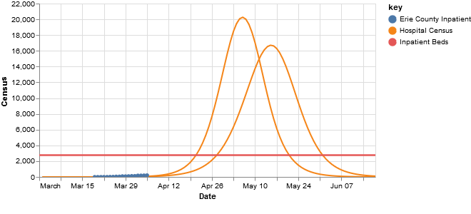
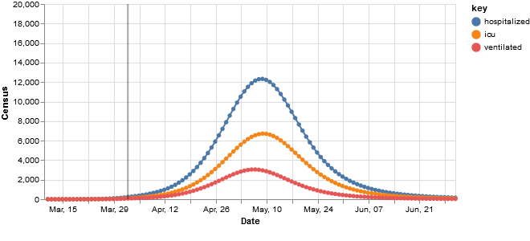
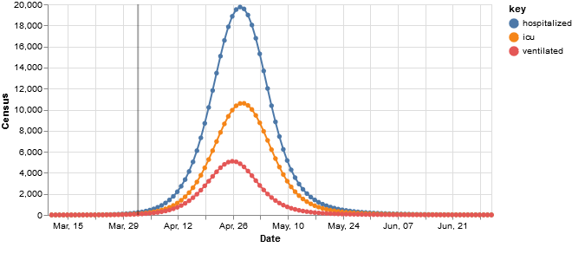
(Old Version) Model Comparison with UPenn
Great Lakes Healthcare
Social Distancing 0%; Peak May 6th
Social distancing step-wise; peak May 15th
U Penn
Social Distancing 0%; peak April 28th
Social distancing 30%; peak may 9th
Notes:
The difference in peaks appears much higher compared to the Upenn as the social distancing that they apply is for the whole model and not step-wise.
You can observe that the SEIR model with 0% SD peaks at the same number, just slight difference in time. 1 week difference.

Slide 24
References

